Slide 1

The Aggregator
Sentiment Analysis Based of IMDb Reviews
Arpine Bandikian, Daniel Rossi, Hossein Esteaneh,
Jackie Huang, William Pryor, Yan Kong

Slide 2




01
Web Scraping
02
Data Clean up
CONTENTS
03
Data Visualization
04
Machine Learning

Slide 3

PART
01
Web Scraping

Slide 4
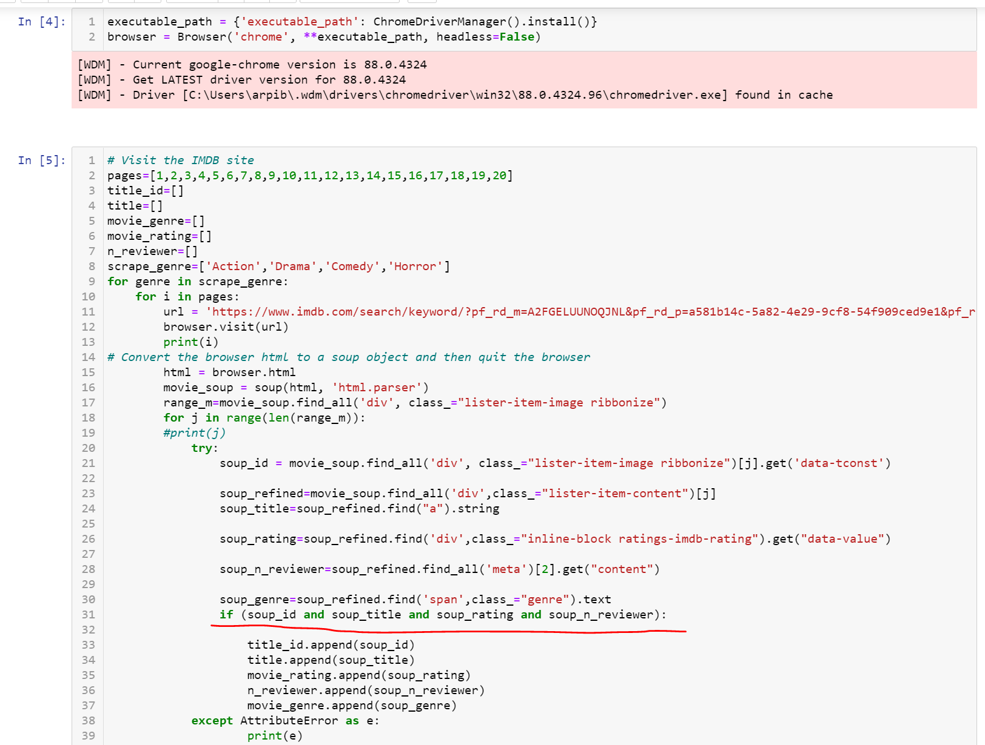
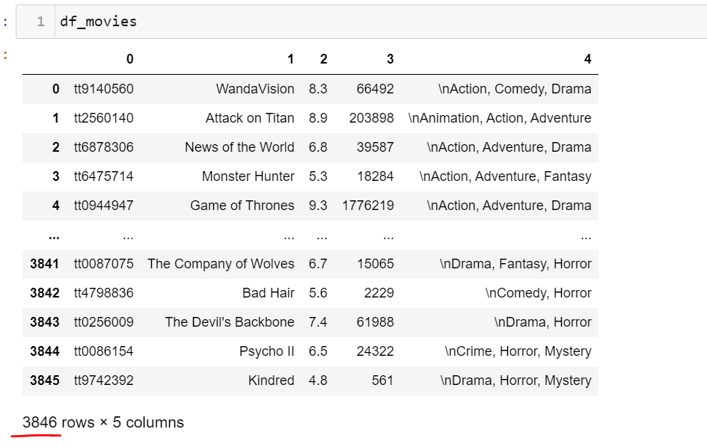
Web Scraping
Beautiful Soup for movie information

Slide 5
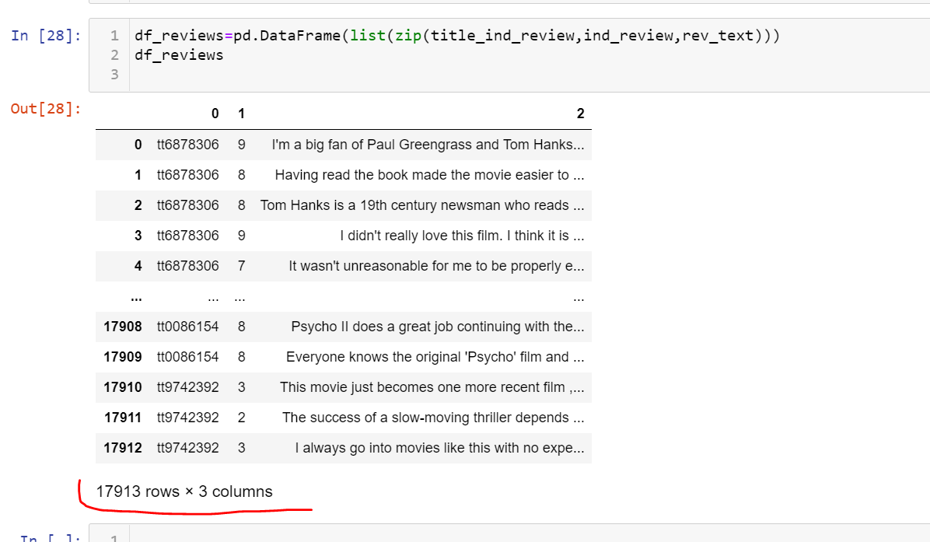
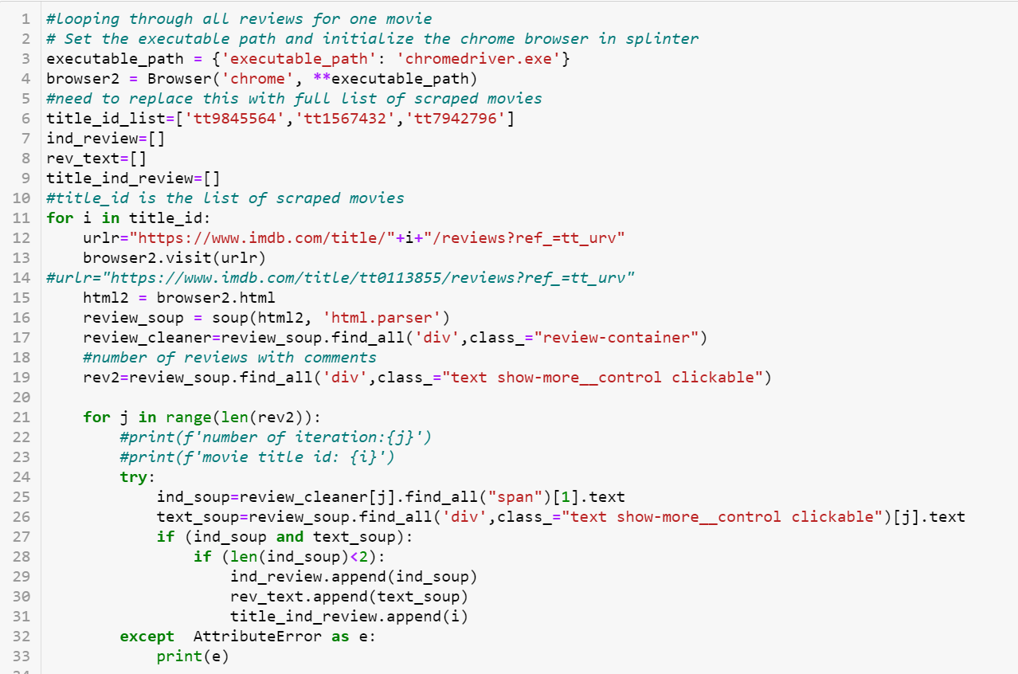
Web Scraping
Scrape individual reviews and rating for each movie

Slide 6
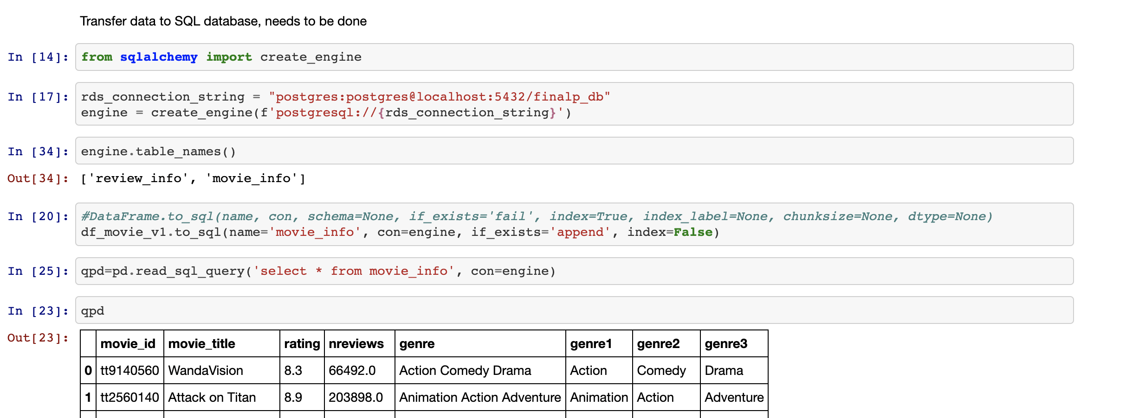
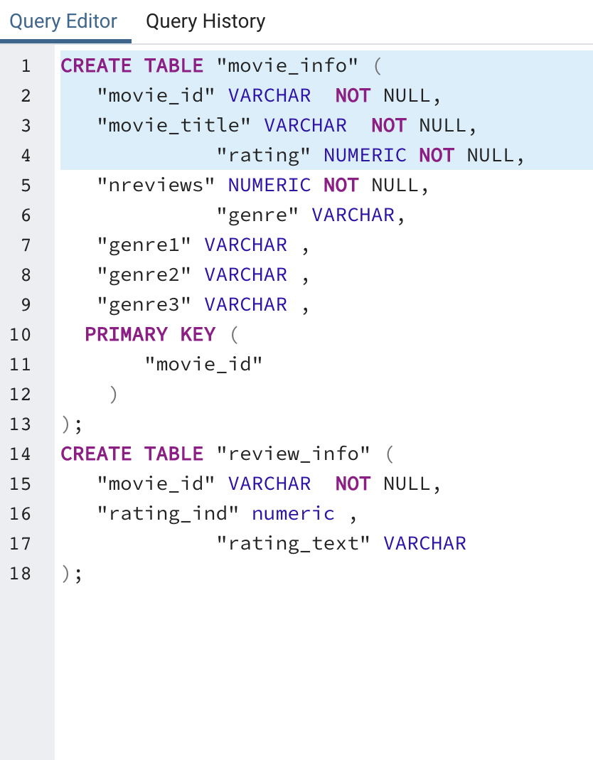
Data Restore
SQL-Postgres

Slide 7
PART
02
Data
Clean up

Slide 8
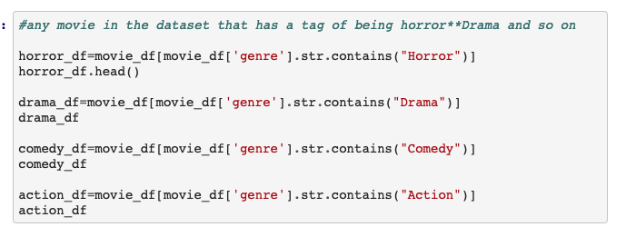
Data Clean up
Drop Duplicate and Retrieve data by genres

Slide 9

Data Clean up
Binary Variables

Slide 10
PART
03
Data
Visualization

Slide 11
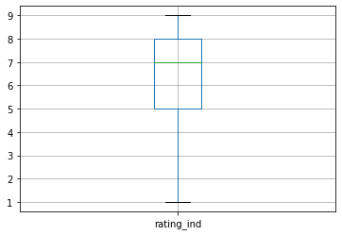

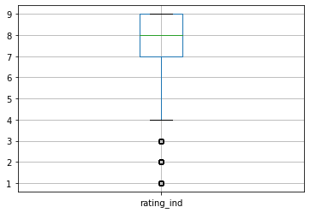
Data Visulization
Boxplot by genres
Action
Drama
Comedy
Horror

Slide 12
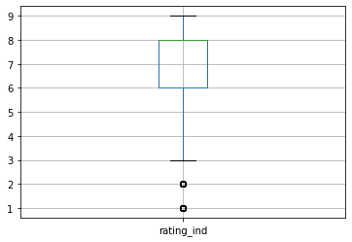
Data Visualization
Boxplot for overall

Slide 13
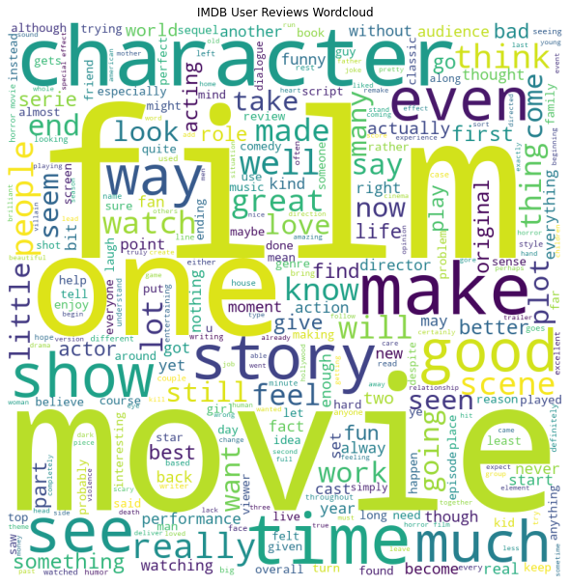
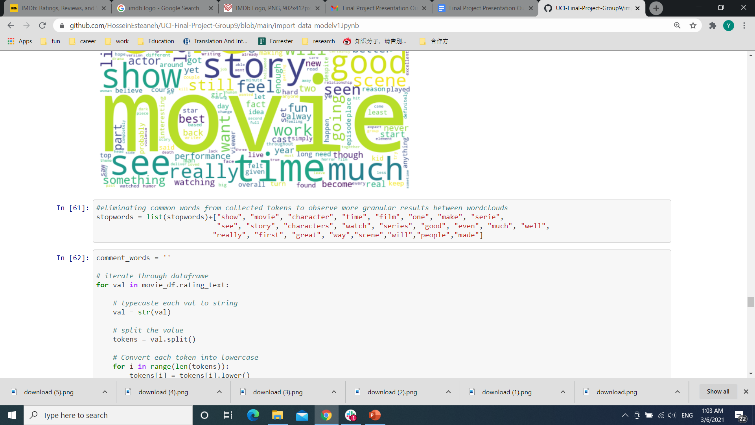
Data Visualization
Word Cloud - Stop words list

Slide 14
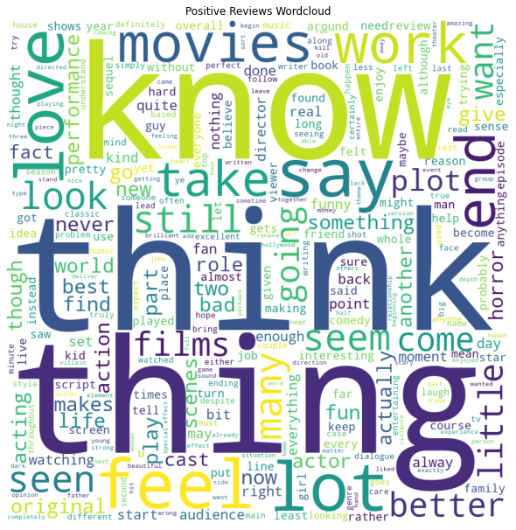
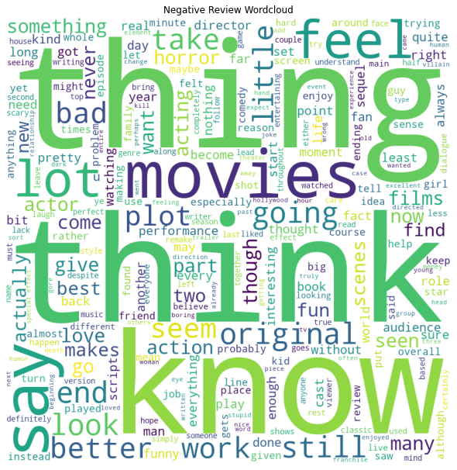
Data Visualization
Word Cloud – Unique words

Slide 15
PART
04
Machine
Learning

Slide 16
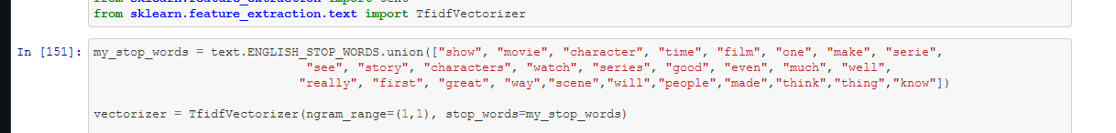
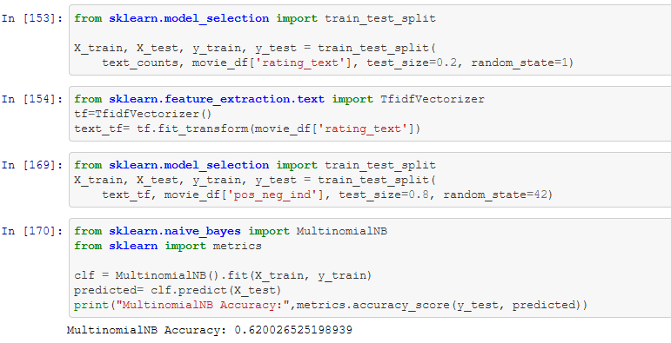
Machine Learning
NLTK and multinomial logistic regression

Slide 17
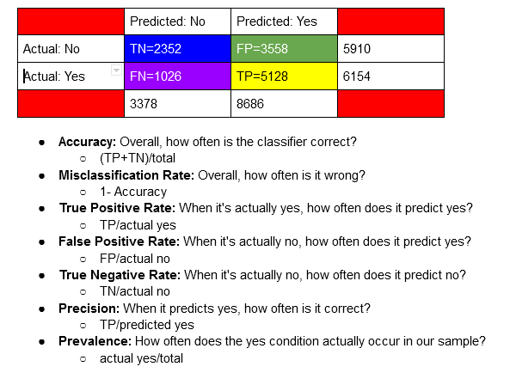
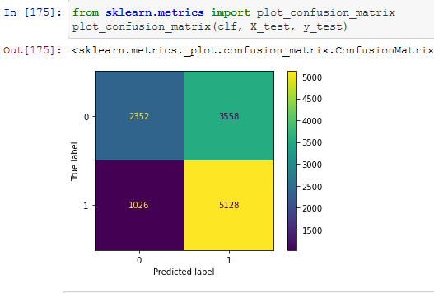
Machine Learning
Confusion Matrix

Slide 18
Conclusions
Increasing the number of reviews and comments scraped for each movie
Pull more specific words:
Adjectives
Adverbs
NLP
Machine Learning
03
02
01

Slide 19
The Aggregator
Thank You!
Arpine Bandikian, Daniel Rossi, Hossein Esteaneh,
Jackie Huang, William Pryor, Yan Kong

